Slide 1


46th IG Meeting
South Gas Regional Initiative
11th April 2018
Teleconference

Slide 2
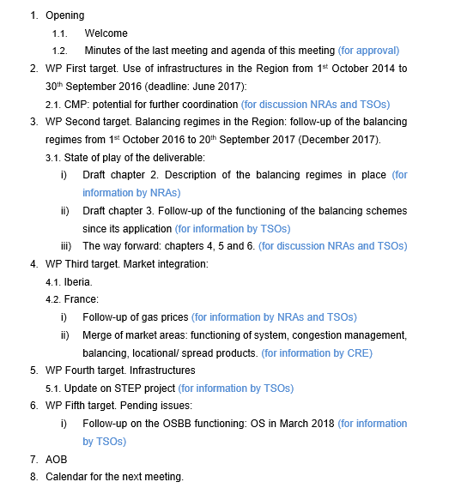
Agenda

Slide 3
2. WP First target: use of infrastructures
2.1. CMP potential for further coordination: the way forward
The way forward agreed on the 45th IG held in February 2018 RCC agreed on asking TSOs: VIP Pirineos: analyzing (backtesting) what had happened in the auctions in three simulations: first, following French rules in both sides; second, following Spanish rules in both sides; and third, with any possible improvement TSO can suggest. VIP Iberico: Since LT UIOLI mechanism must be developed in Portugal, analyzing historical flows and LT bookings at both sides in order to decide how to proceed. ACER is invited to give their criteria on how it must be applied the LT UIOLI mechanism across Europe.
For information by TSOs

Slide 4
3. WP Second target: balancing
  Aim: Assessing and drawing learnings from the implementation of the balancing NC in the three countries of the Region
  To address this report is essential to have homogenous and comparable information from the three countries of chapters 2 and 3 (description of the regimes and follow-up of the functioning (data since the entry into force)
  Information received until now does not stick to the requested
  These issues have been underlined and complete information has been requested by email since December without success.
  The way forward?
For discussion by NRAs and TSOs

Slide 5
4. WP Third target: Market integration
  4.1. Iberia (for information by NRAs)
State of play and way forward

Slide 6
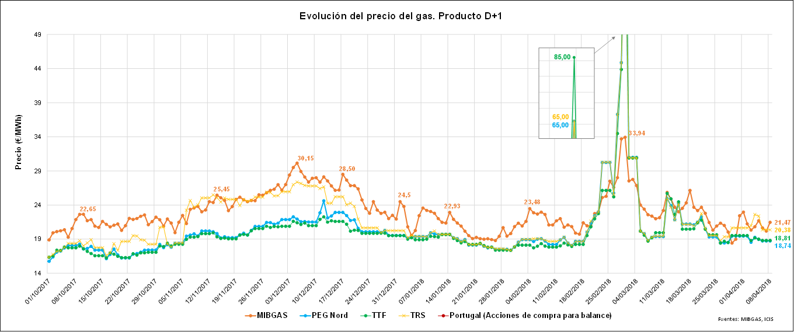
4. WP Third target: Market integration
  4.2. France: gas prices and internal congestions (for information by NRAs and TSOs)
  i) Follow-up of gas prices SGRI hubs vs. neighbouring hubs
  Evolution of prices D+1 (1st October 2017- 8th April 2018)

Slide 7
4. WP Third target: Market integration
  4.2. France: gas prices and internal congestions (for information by CRE and TSOs)
  ii) Update on the creation of a single gas market area in France
  Presentation on merge of market areas in France: congestion management, balancing, locational/spread products….
  (for information by CRE)

Slide 8
  5.1. Update on infrastructures development (for information by TSOs)
5. WP Fourth target: Infrastructures
  Update on STEP project
  (for information by TSOs and NRAs)

Slide 9
6. WP Fifth target: Pending issues
6.1. Follow-up on the OSBB functioning (for information by TSOs)
    Results of the application of the mechanism until now: OS in march 2018
    (for information by TSOs)

Slide 10
7. AOB

Slide 11

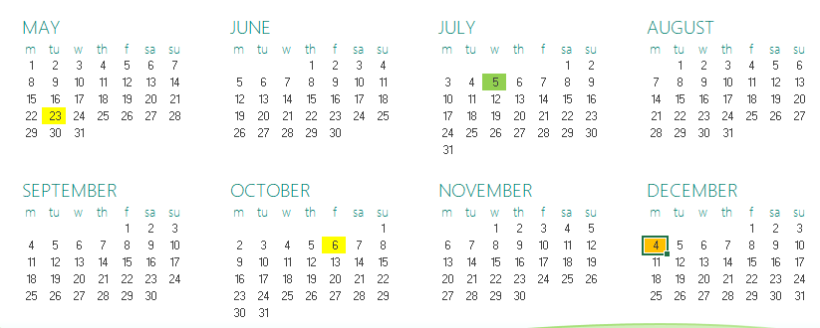
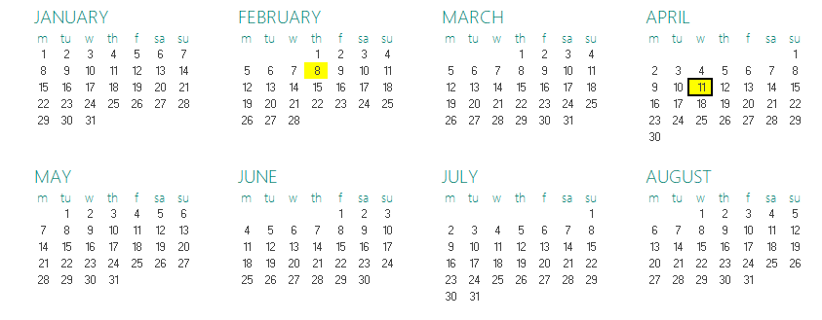

8. Calendar of the next meeting
SG
IG
RCC
Next IG meeting: tbd (tentative date: XX June)

Slide 12
Thank you for your participation

